Slide 1
How to Apply for Federal & State Aid

Slide 2
FEDERAL STUDENT AID ID or FSAID
https://studentaid.gov

Slide 3
What is the FSA ID?
An account username and password is used by students, parents, and borrowers to log in to U.S. Department of Education online systems and to electronically sign documents.
You use it to
apply for federal student aid;
sign for a federal student loan; and
perform important activities such as choosing a repayment plan or applying for a deferment on your federal student loan.
3

Slide 4
Do Parents Need an FSA Account?
If you’re a dependent student, then your parent will need an account username and password in order to sign your Free Application for Federal Student Aid (FAFSA®) form electronically.
IMPORTANT
You and your parent must have different account usernames and passwords (NOTE: A Social Security number can be associated with only one account username and password).
You must create your own account username and password—it’s your electronic signature and you need to own it.
Your parent must create his or her own account username and password.
You and your parent should each use your own email address and mobile phone number when creating an account username and password (NOTE: A mobile phone or an email address can be associated with only one account username and password).

Slide 5
How do you create your FSA ID?
5

Slide 6
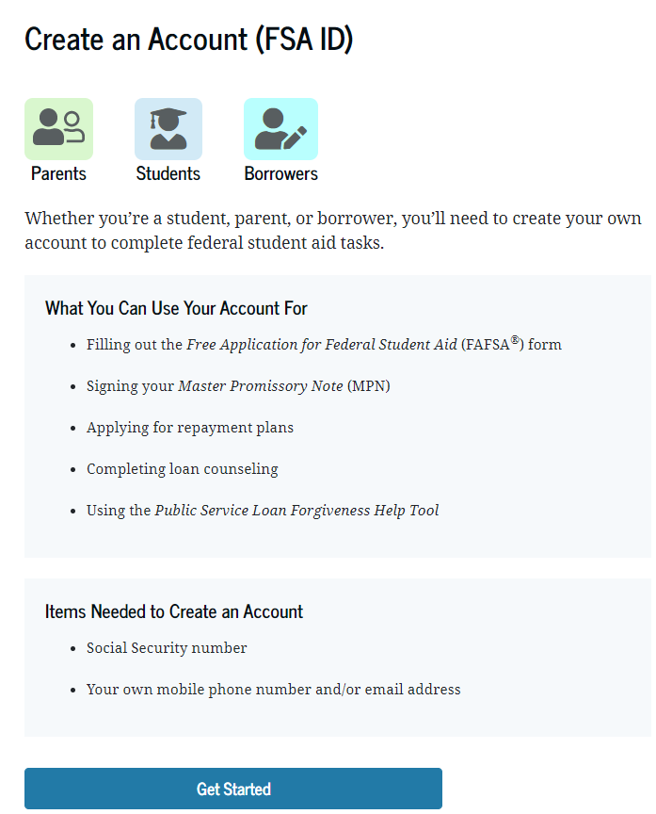
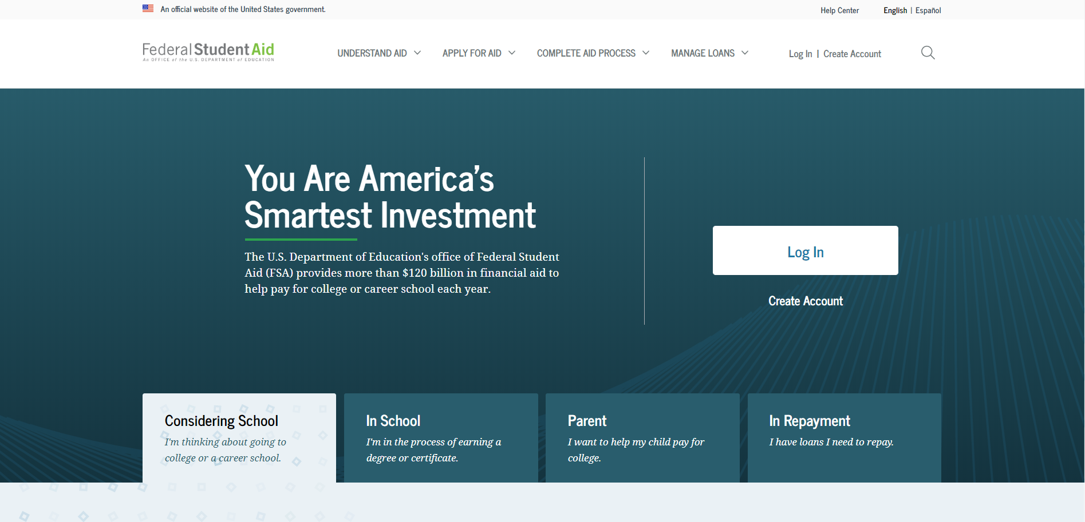
Getting Started
Go to: https://studentaid.gov/fsa-id/create-account/launch.
Click the “Create Account” and “Get Started”
6

Slide 7
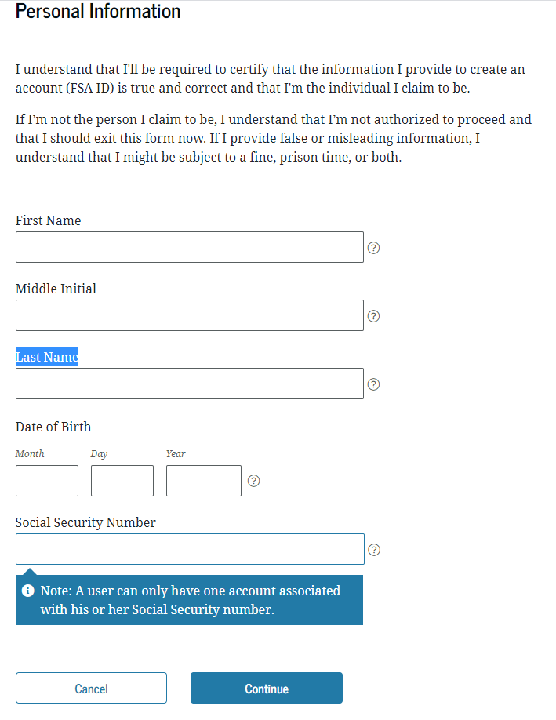
Provide Personal Identification Information
Make sure your Social Security number (SSN), date of birth, and name match what’s on your Social Security card.
You must have an SSN to create an account username and password.
NJDREAMERS DO NOT REGISTER FOR an FSAID (Register at www.HESAA.org)
7

Slide 8
Create Your Account Username and Password
Username:
Don’t include personal info such as date of birth or name.
If you see a message “The username you entered is already in use,” then someone has already used that username.
Password:
Your password must be between 8 and 30 characters in length, and must contain at least one uppercase letter, one lowercase letter, and one number.
Your password is case-sensitive.
8

Slide 9
Your Account Is Created
If you provided an email address, you’ll receive a confirmation email.
You can immediately use your account username and password to sign an original (first-time) FAFSA form.
Your info will be sent to the Social Security Administration (SSA) for confirmation.
SSA review will take 1–3 days.
Until your info is verified, you won’t be able to take certain actions, such as correcting your FAFSA form, submitting a FAFSA Renewal, or signing forms such as the Income-Driven Repayment Plan Request and Direct Consolidation Loan Application.

Slide 10
FAFSA
FREE APPLICATION
FOR FEDERAL STUDENT AID
STUDENTAID.GOV

Slide 11
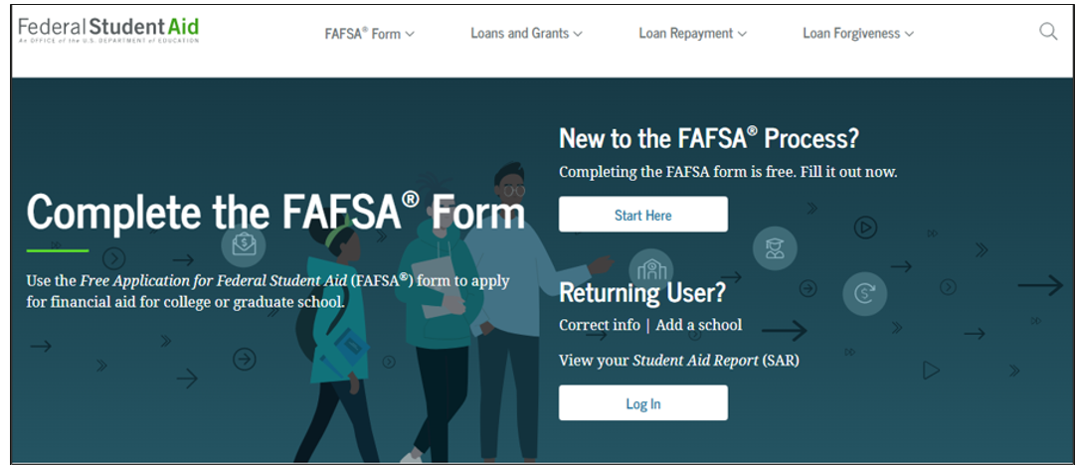
Studentaid.gov
Notes:
2020-21 fafsa.gov home view. Top section of view.
The fafsa.gov home view features a two-button login option and current announcements, as well as an easy-access tool bar, featuring links to studentaid.gov and loan information.

Slide 12
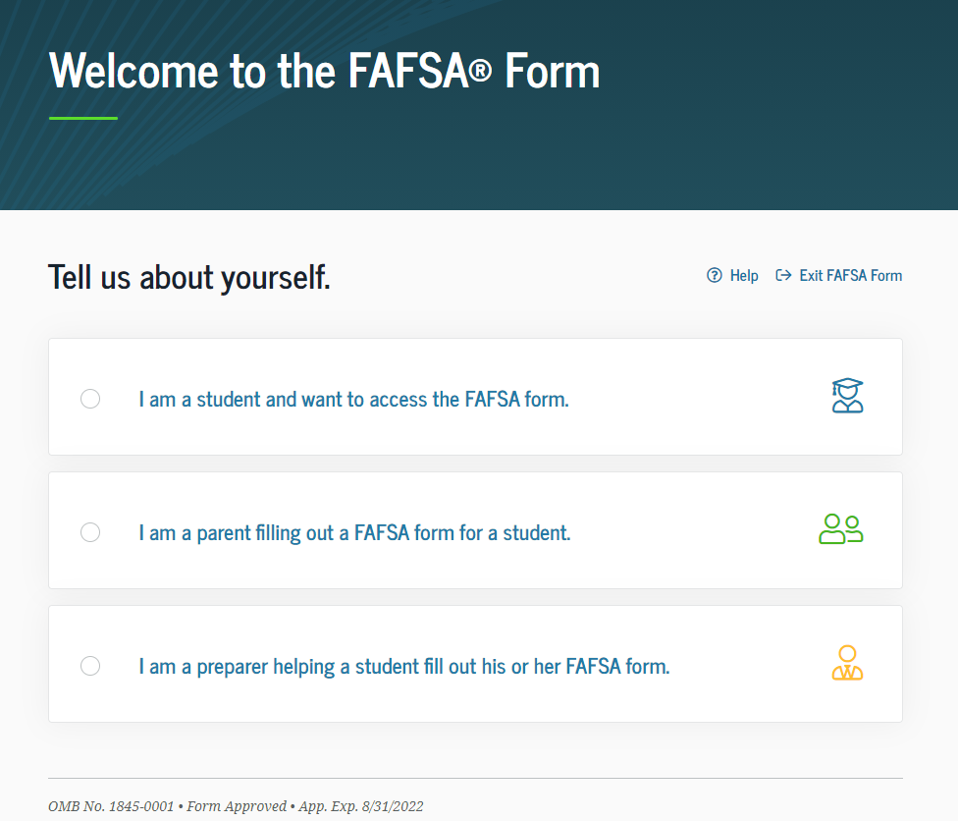
Role Selection

Slide 13
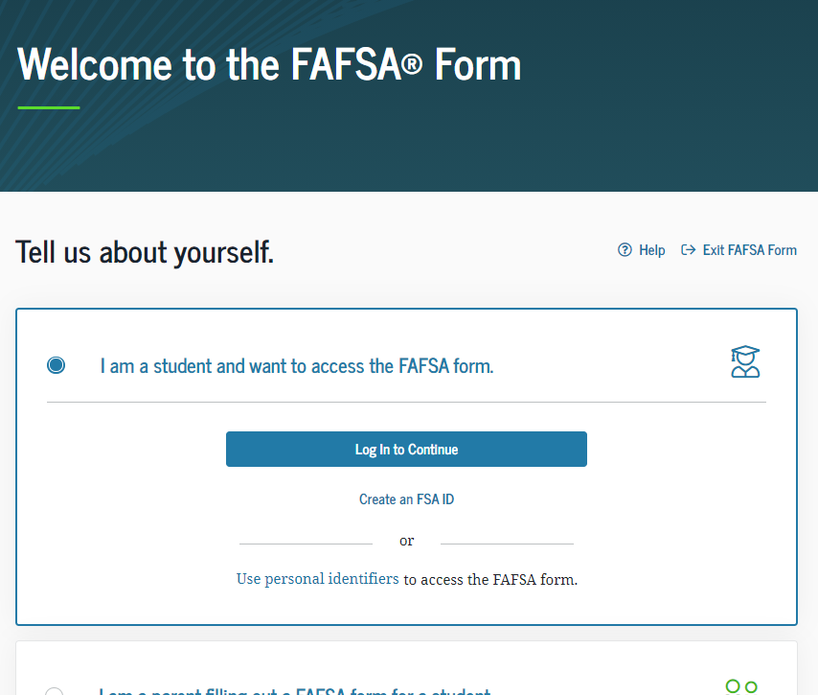

Slide 14
Login – I am the Student
Notes:
2020-2021 “Login to view with the I am the student option selected. Students can create and FSA ID from her or the can begin the application by clicking “student identifiers”
Note: It is beneficial for the student /parent to include an email address on their FSA ID account to allow the U.S. Department of education to communicate directlry with the fsaid owner about the status of their account. the email address is entered when the student/parent applies for their FSA ID.
Reminder : while the email address for the FSA Id is optional, if the uuser does want to include an email address, it can be used only one with the FSAId. Is users share an email address, only one user may link the email address to the fsa id

Slide 15
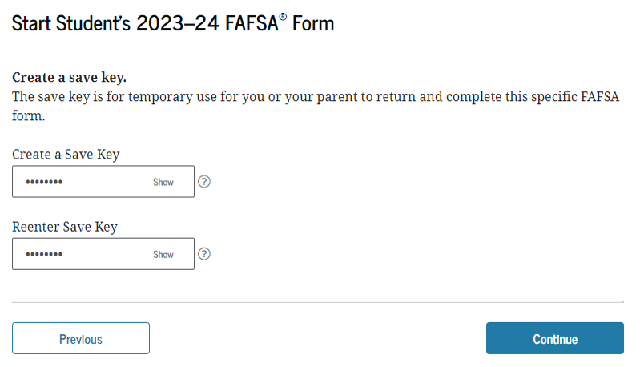
SAVE Key

Slide 16
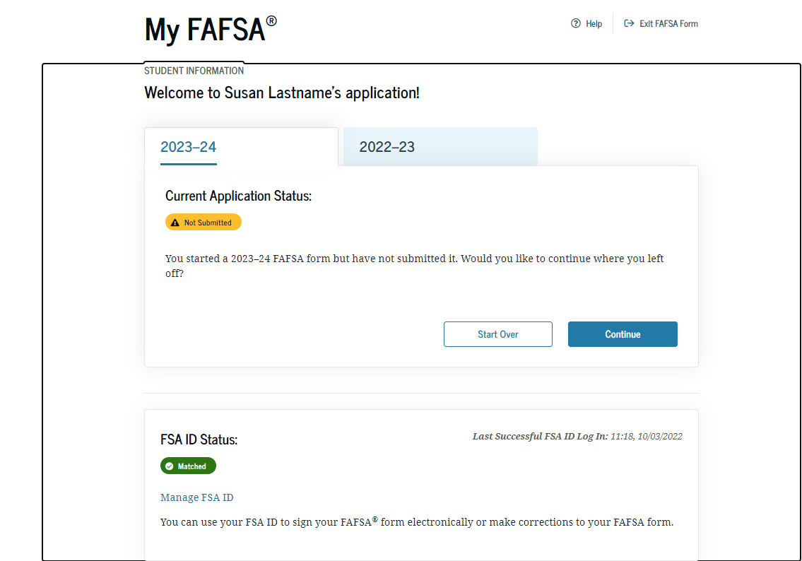
Login – I am the Parent, Preparer or Student from a Freely Associated State
Notes:
2020-21 “Login” view with the “I am a parent, preparer, or student from a Freely Associated State” option selected.
The SSN is now masked by default and users have the ability to check the “Show SSN” box if they wish to see what is being typed in.

Slide 17
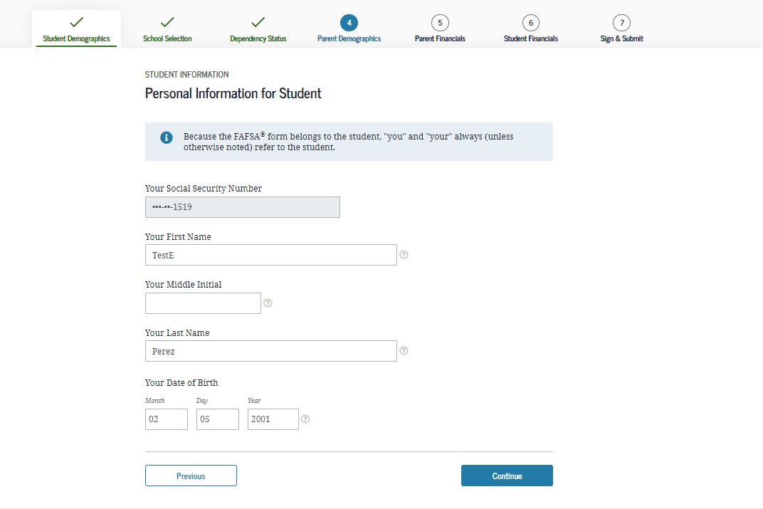
Create a Save Key
Student Demographics
If the student logs in with their FSAID, information used to create it, such as SSN, will be prepopulated.
The information you enter must also match the information entered in the FSAID Registration.
Notes:
2020-21 “Create a Save Key” view.
The “Save Key” allows an applicant to save their FAFSA application and return at a later time to complete and submit the application. The application is saved for 45 days, unless the student submits their application for processing prior to that. Additionally, the Save Key provides applicants a way to share access to their Free Application for Federal Student Aid (FAFSA®) application or correction if their parent(s) needs to add information or sign it.

Slide 18
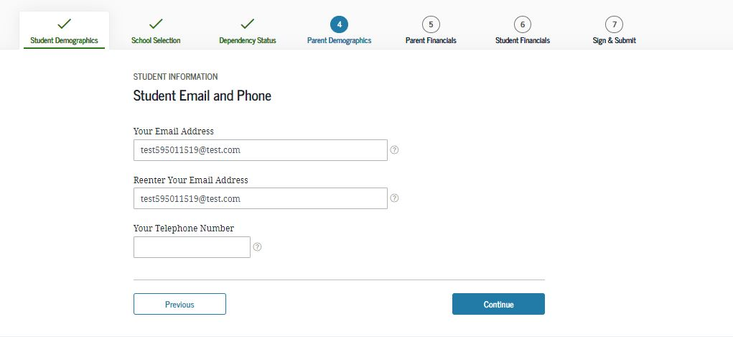
Student E-mail and Phone - Dependent
Notes:
2020-21 “Student E-mail and Phone” view.
This view is new to 2020-21, as email and phone are now on one page to sync fafsa.gov and the mobile app.
Note: While not mandatory, it is beneficial for the student/parent to include an e-mail address on the FAFSA application in order to receive important communications about their financial aid.

Slide 19
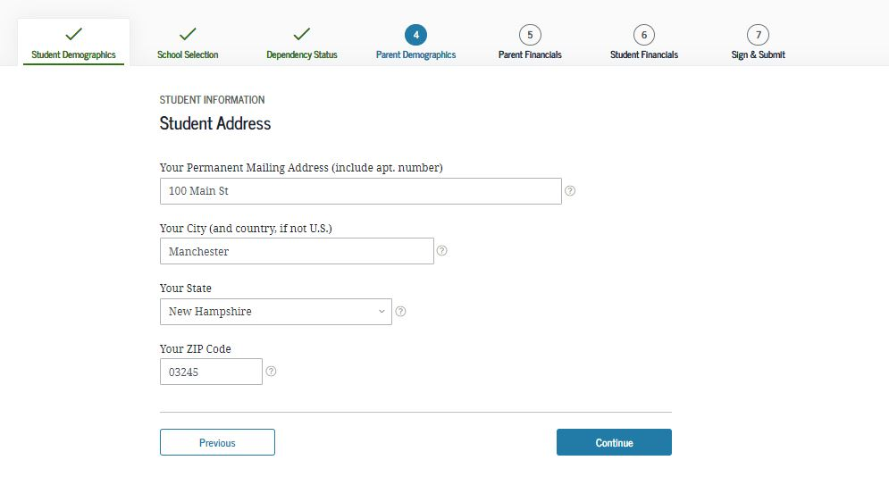
Student Address - Dependent
Notes:
2020-21 “Student Address” view.
Note: Email address is no longer on this page as it has been given it’s own page.

Slide 20
Citizenship Status
A permanent U.S. resident with a Permanent Resident Card (I-551);
A conditional permanent resident with a Conditional Green Card (I-551C);
The holder of an Arrival-Departure Record (I-94) from the Department of Homeland Security showing any one of the following designations: “Refugee,” “Asylum Granted,” “Parolee” (I-94 confirms that you were paroled for a minimum of one year and status has not expired), T-Visa holder (T-1, T-2, T-3, etc.) or “Cuban-Haitian Entrant;” or
The holder of a valid certification or eligibility letter from the Department of Health and Human Services showing a designation of “Victim of human trafficking.”
Other Option - No, I am not a U.S. Citizen or eligible noncitizen
Must complete the New Jersey Alternative Financial Aid Application

Slide 21
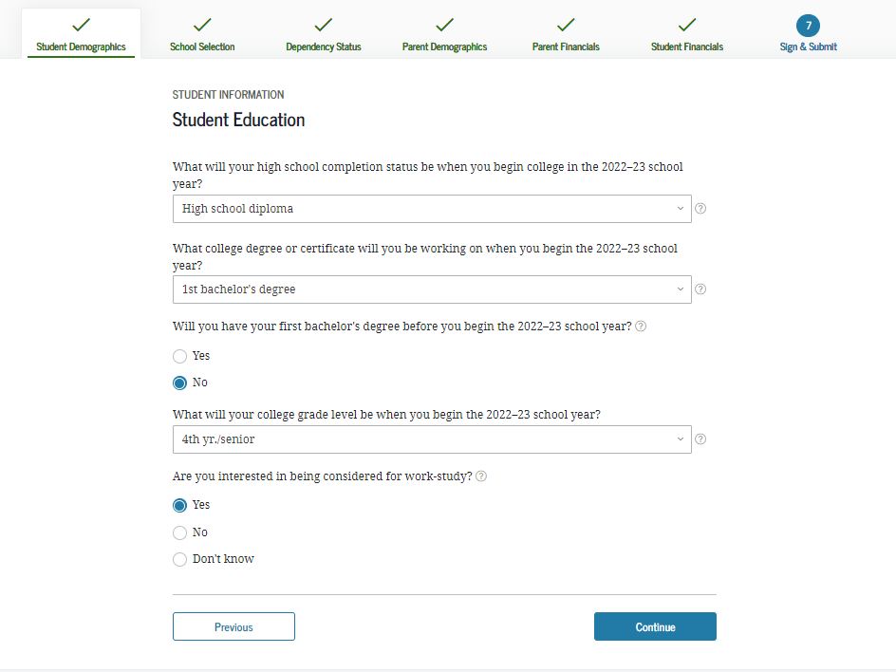
Student Education - Dependent
Never attended college, first year
Notes:
2020-21 “Student Education” view.
Note: Question 30 has been updated to now include the word “college” in order to help applicants answer the question properly.

Slide 22
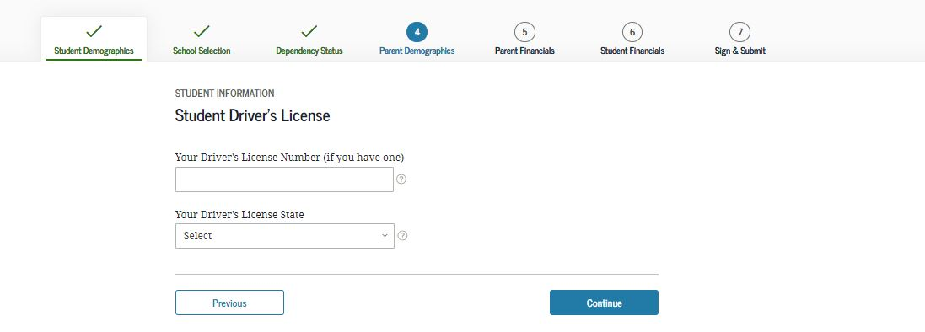
Student Driver’s License - Dependent
Notes:
2020-21 “Student Driver’s License” view.
This view is new to 2020-21, as driver’s license number and driver’s license state are now on one page to sync fafsa.gov and the mobile app.

Slide 23
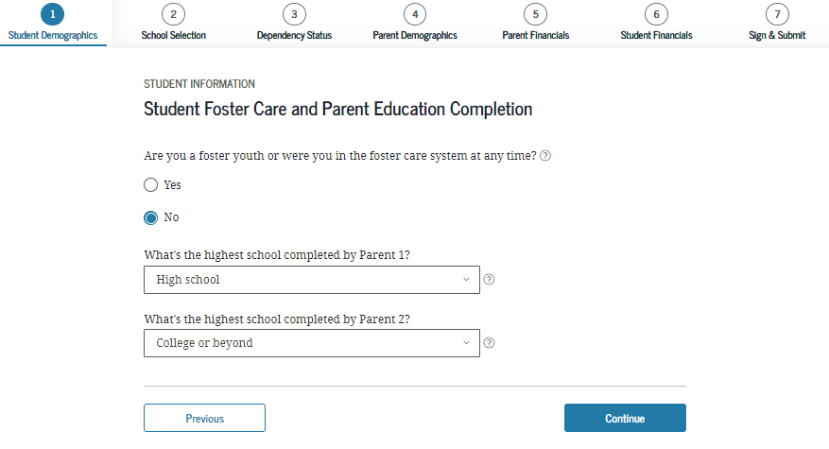
Student Foster Care/Parent Education Completion - Dependent
Check the box if you were in foster care at any time since you turned age 13, even if you are no longer in foster care as of today.
Notes:
2020-21 “Student Foster Care/Parent Education Completion” view.

Slide 24
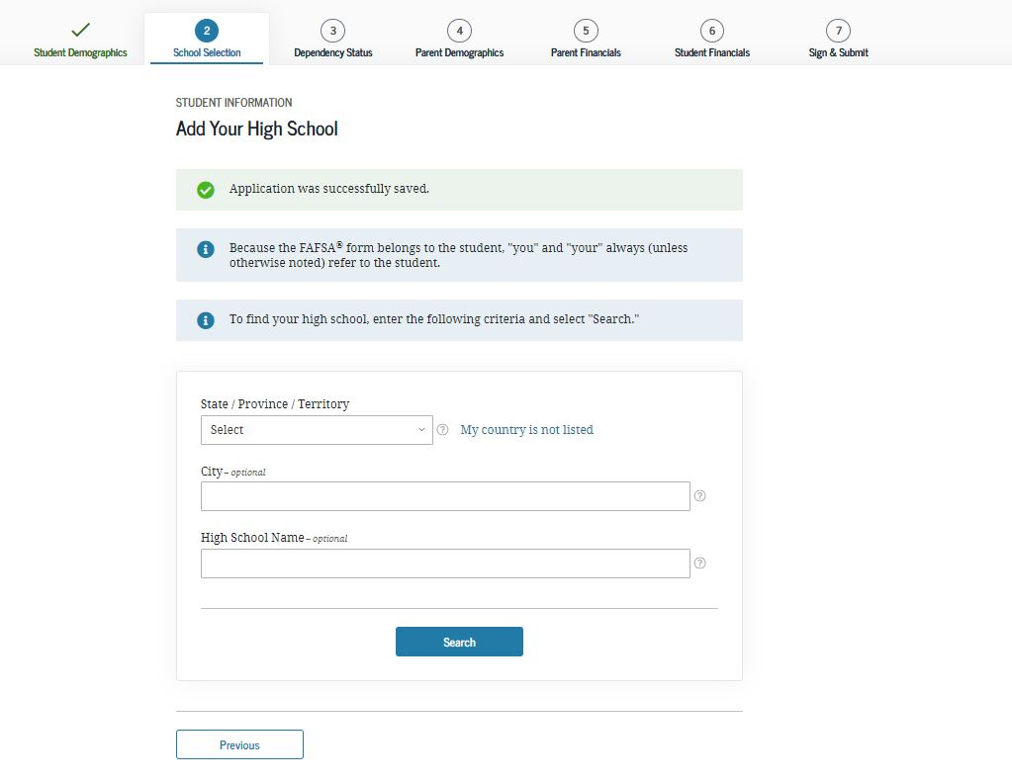
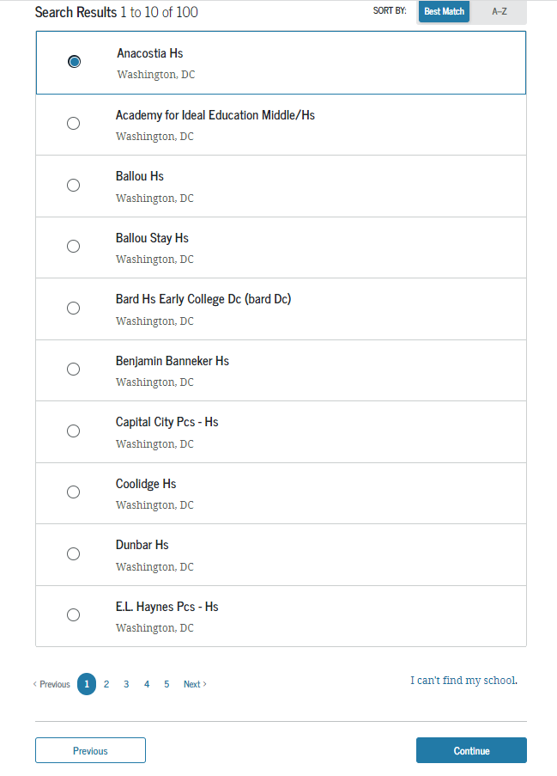
Search for High School - Dependent
High School Selection
Use the search feature for accurate results.
Notes:
2020-21 “Search for High School” view.
Note: This is the first view for the School Selection section.

Slide 25
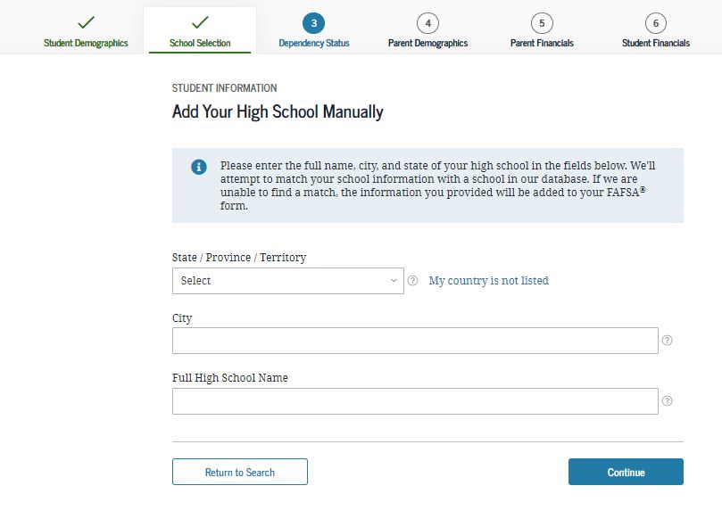
Search for High School Results - Dependent
Manual High School Selection
HESAA runs reports for school districts. Please enter your high school from the search results. This brings consistency for all students. If the student enters the wrong high school name, they will not match the report.
For Example:
John F Kennedy High School
JFK High School
Kennedy High School
J F Kennedy High School
Notes:
2020-21 “Search for High School Results” view.

Slide 26
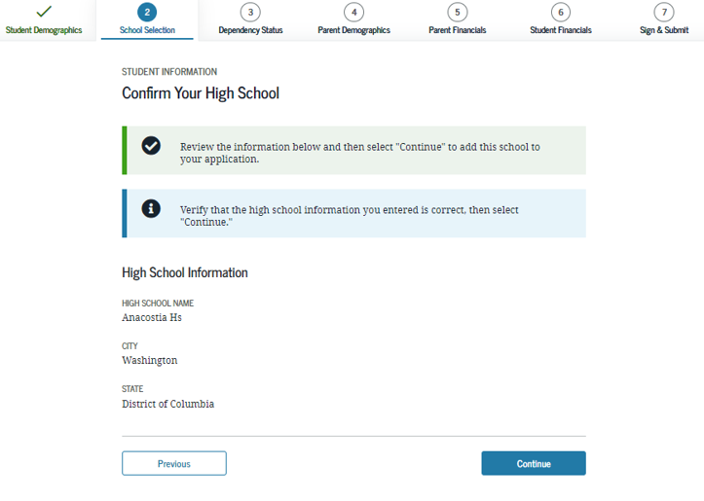
Newark High School
Newark
New Jersey
Notes:
The next two slides to confirm HS.

Slide 27
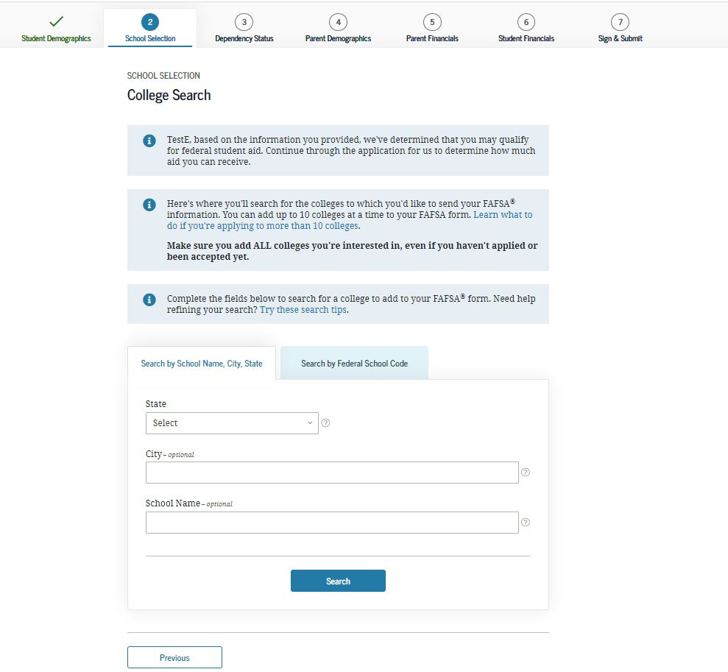
Search for Colleges - Dependent
College Search
Notes:
2020-21 “Search for Colleges” view.

Slide 28
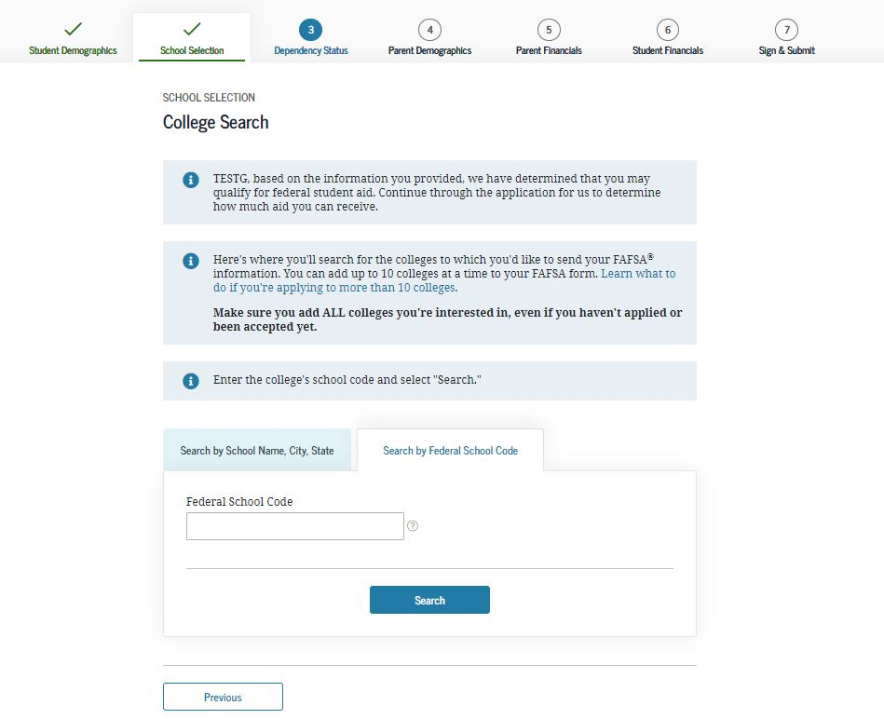
Selected Colleges and Housing Plans - Dependent
Select Up to 10 Colleges
Notes:
2020-21 “Selected Colleges and Housing Plans” view.

Slide 29
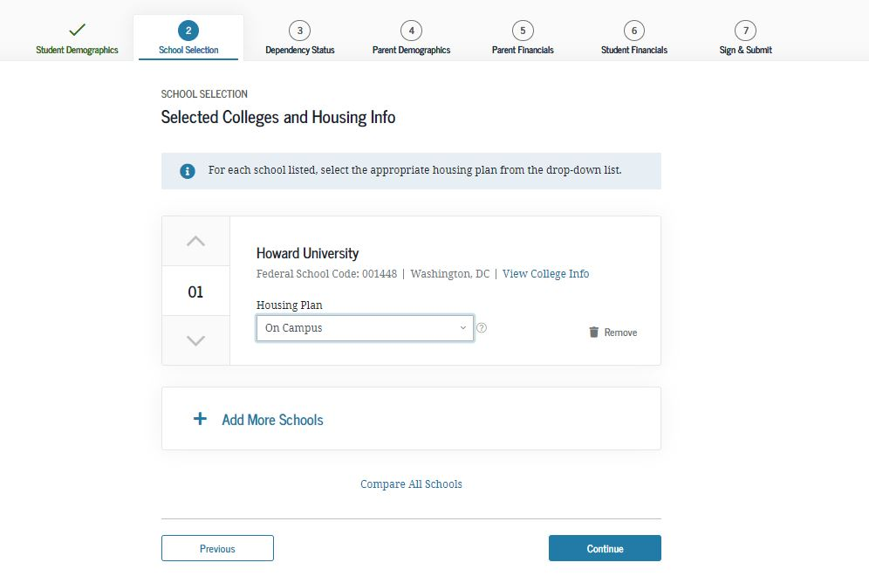

Slide 30
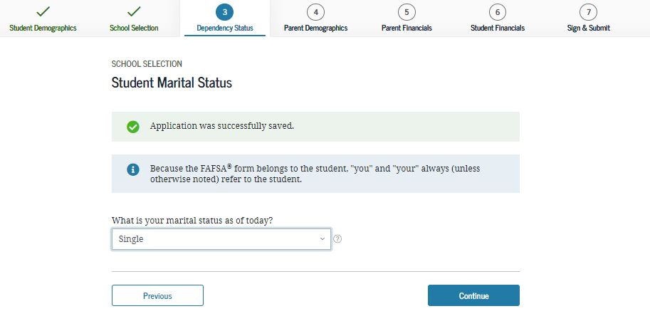
Student Marital Status - Dependent
Dependency Status
Notes:
2020-21 “Student Marital Status” view.
Note: This is the first view of the Dependency Status section, this view is also a new view in order to sync fafsa.gov and the mobile app.

Slide 31
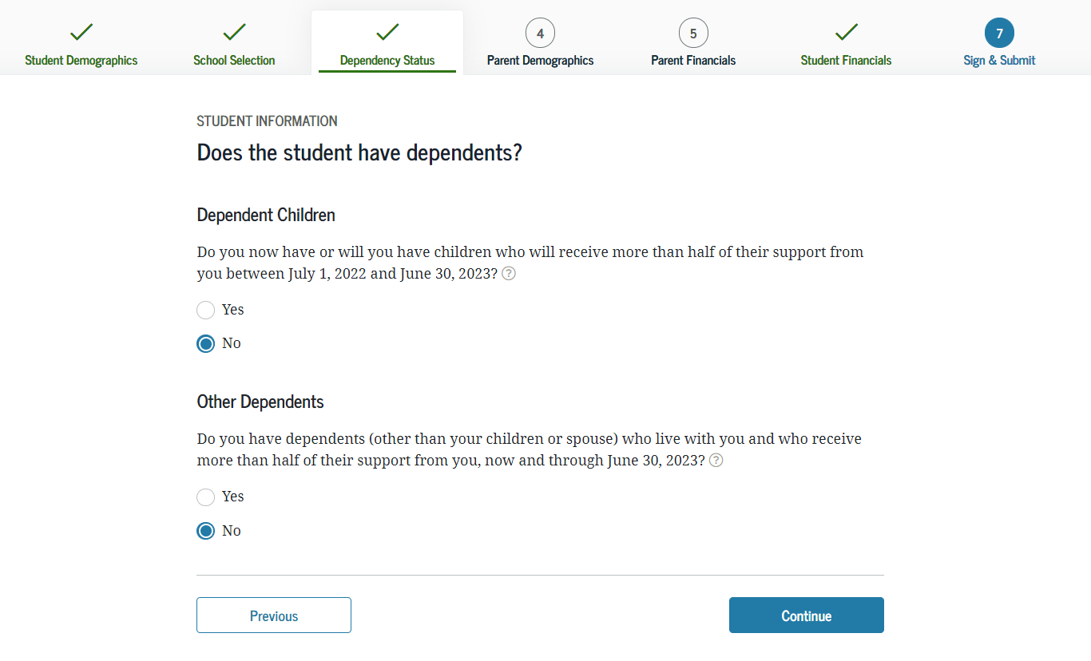
Does Student Have Dependents? - Dependent
Notes:
2020-21 “Does Student Have Dependents?” view.

Slide 32
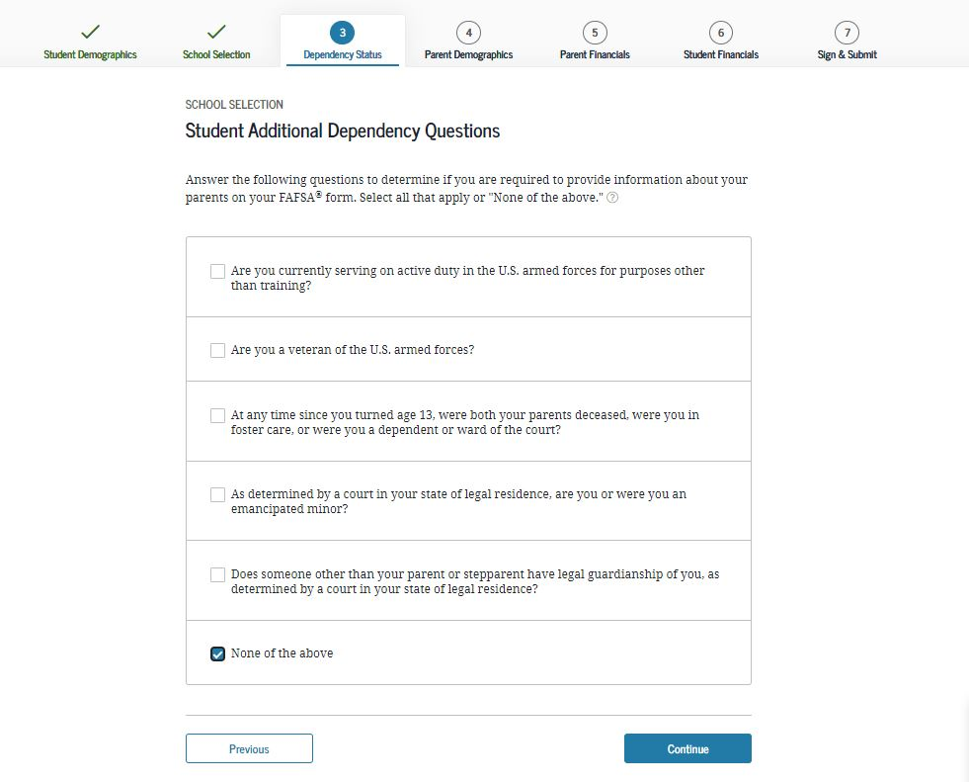
Student Additional Dependency Questions - Dependent
Notes:
2020-21 “Student Additional Dependency Questions” view.

Slide 33
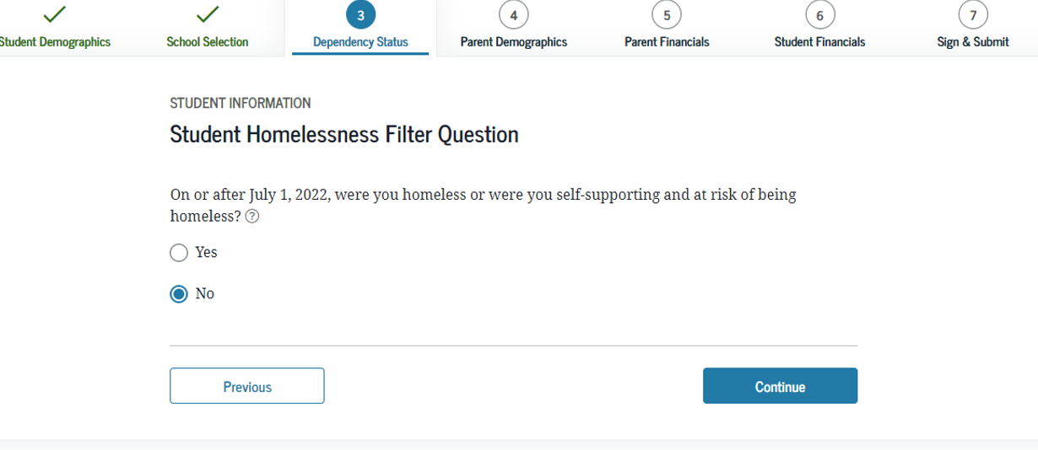
Student Homelessness Filter Question - Dependent
Notes:
2020-21 “Student Homelessness Filter Question” view.

Slide 34
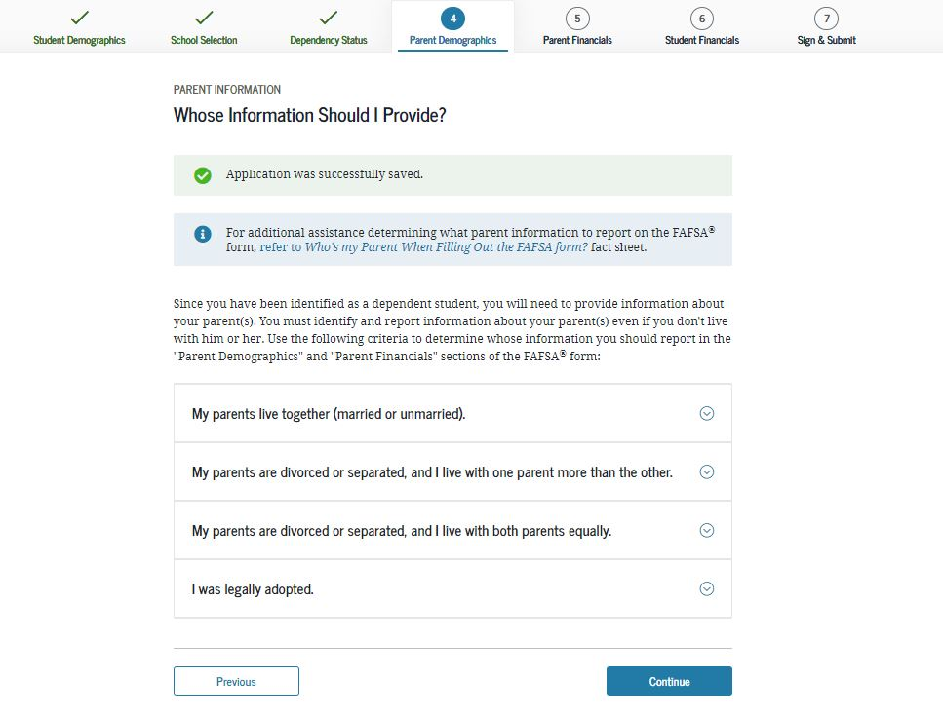
Parent Demographics

Slide 35
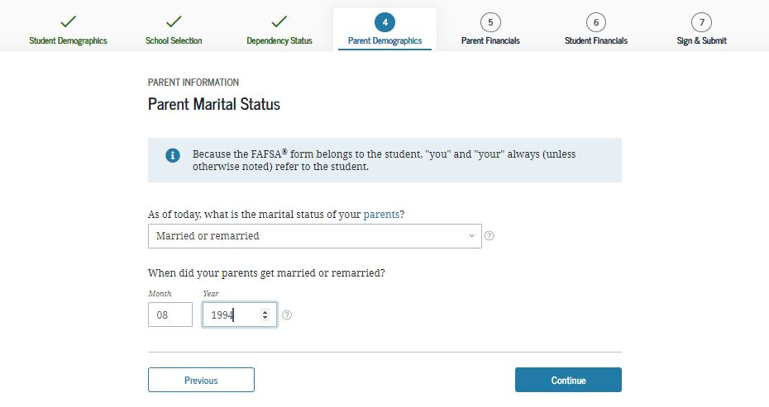
Parent Marital Status - Dependent
Notes:
2020-21 “Parent Marital Status” view.
Note: This is the first view in the Parent Demographics section.

Slide 36
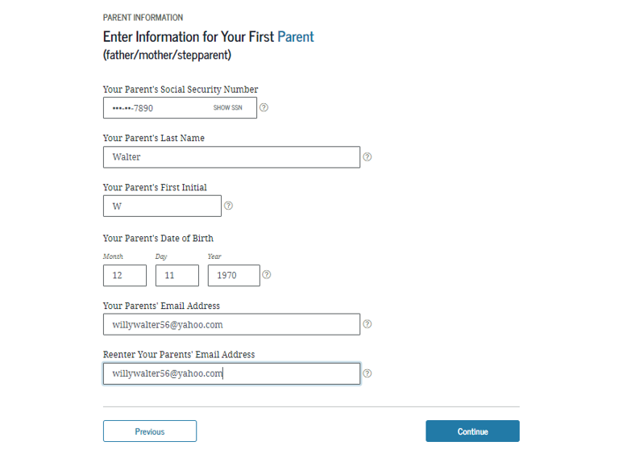
Personal Information for Parent - Dependent
Parent One
Notes:
2020-21 “Personal Information for Parent” view.
Parent e-mail is now a part of the information page instead of its own page.

Slide 37
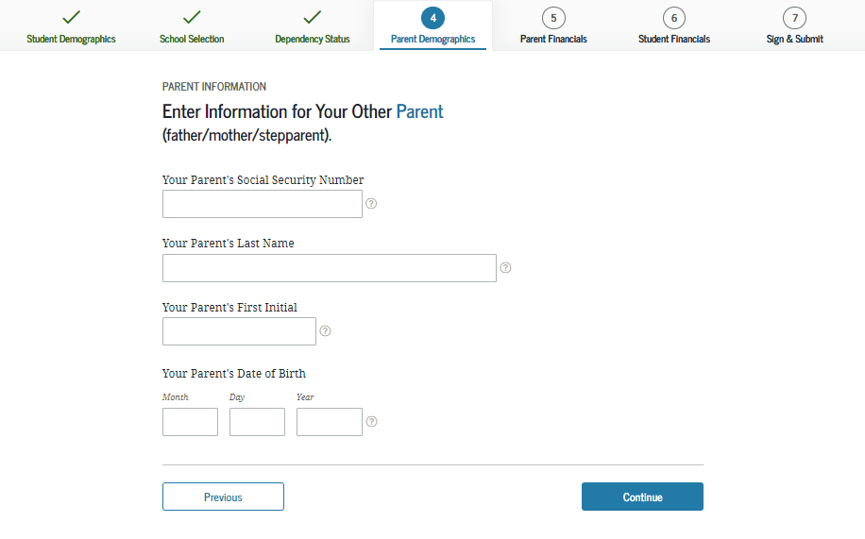
Personal Information for Other Parent - Dependent
Parent Two
Notes:
2020-21 “Personal Information for Other Parent” view.

Slide 38
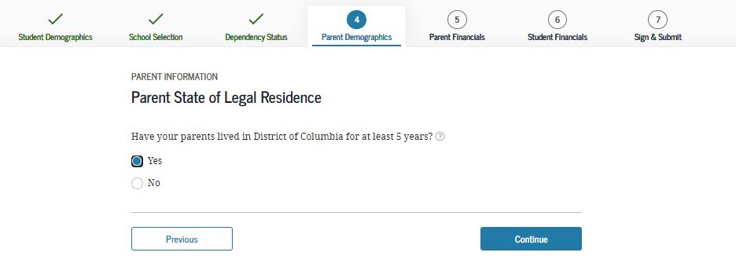
Parent State of Legal Residence - Dependent
Notes:
2020-21 “Parent State of Legal Residence” view.

Slide 39
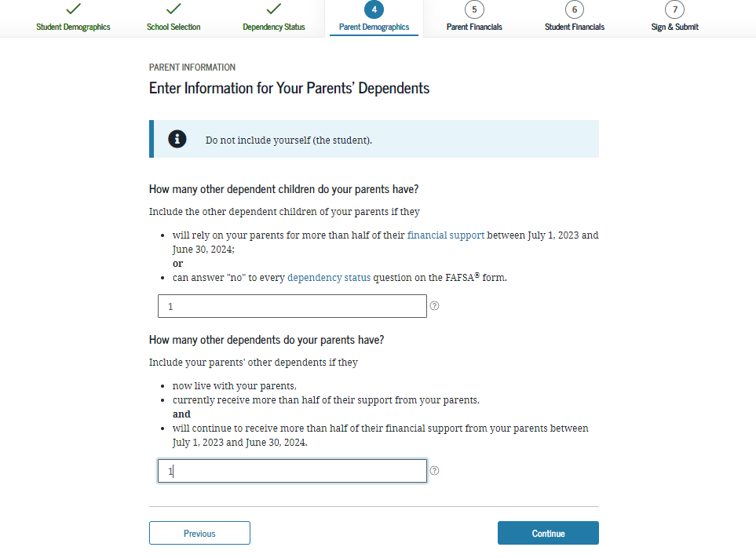
Parent Household Info - Dependent
Notes:
2020-21 “Parent Household Info” view.
Parents are required to complete the household size worksheet in an effort to get more accurate information about the number in the parent’s household and the number of those in the household who are in college. Some information will be prefilled, based on responses provided previously within the FAFSA form. The system tallies the totals as the parent completes the worksheet to ensure that there are no mathematical errors.

Slide 40
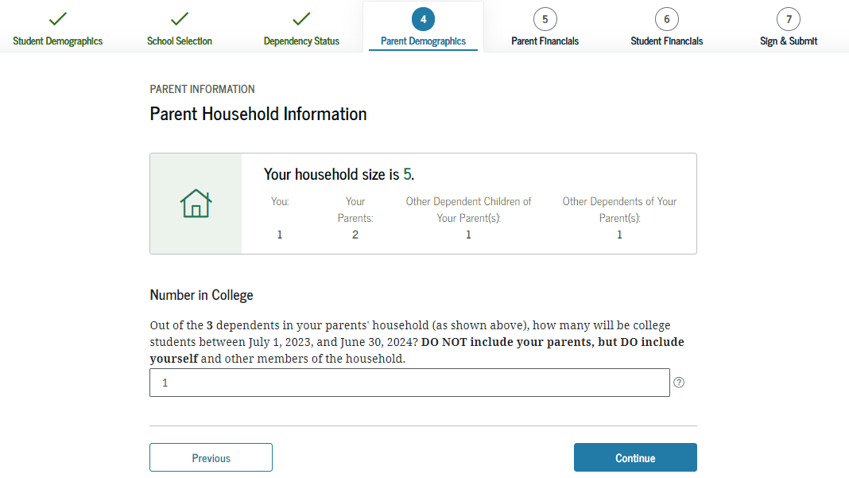

Slide 41
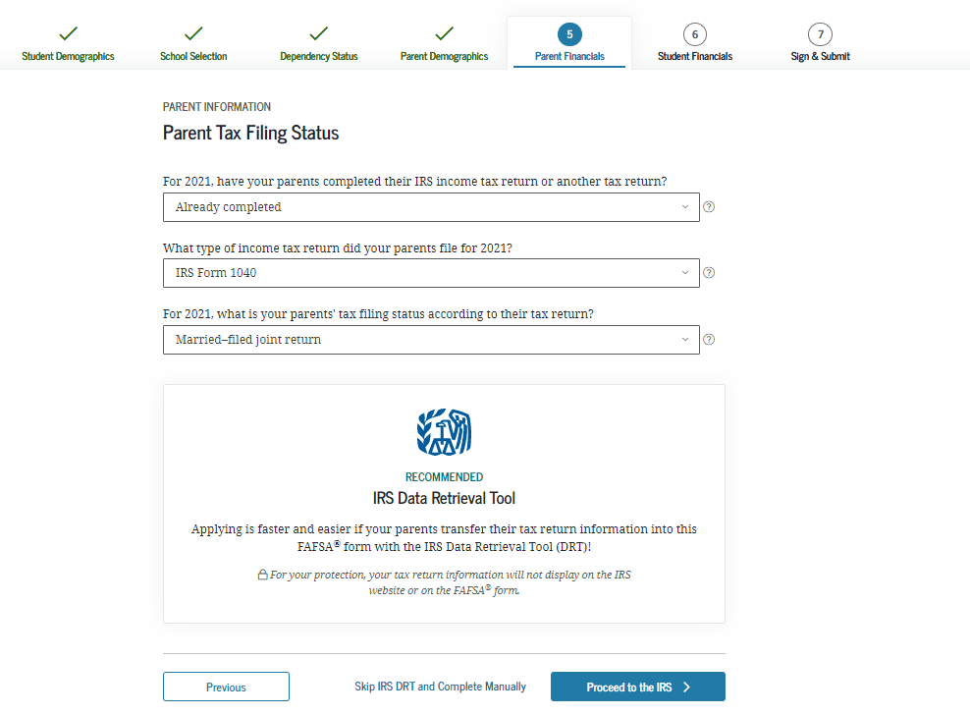
Parent Tax Filing Status – Dependent
Parent Financials - 2021 Income Tax Information
Notes:
2020-21 “Parent Tax Filing Status” view.
The tax return type dropdown question is now displayed on this page.
Note: This is the first view in the Parent Financials section.

Slide 42
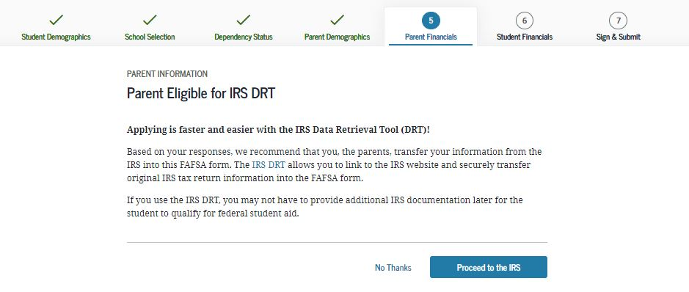

Slide 43
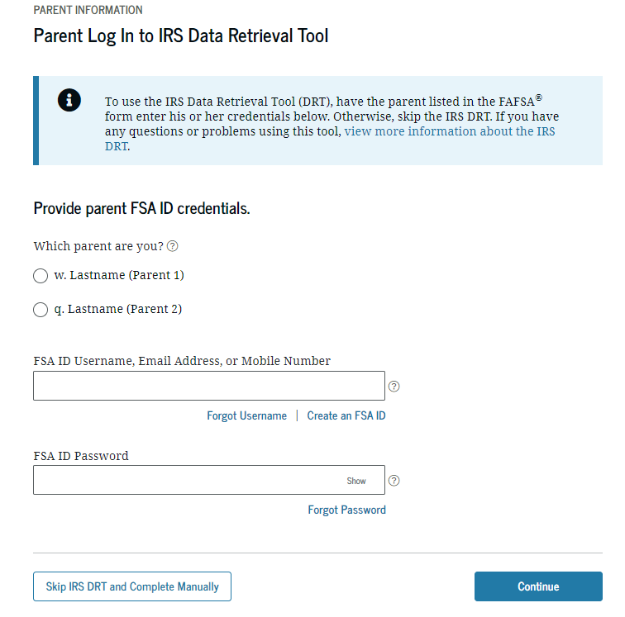
Parent Log In to the IRS DRT - Dependent
IRS Data Retrieval Tool - DRT
Notes:
2020-21 “Parent Log In to the IRS DRT” view.

Slide 44
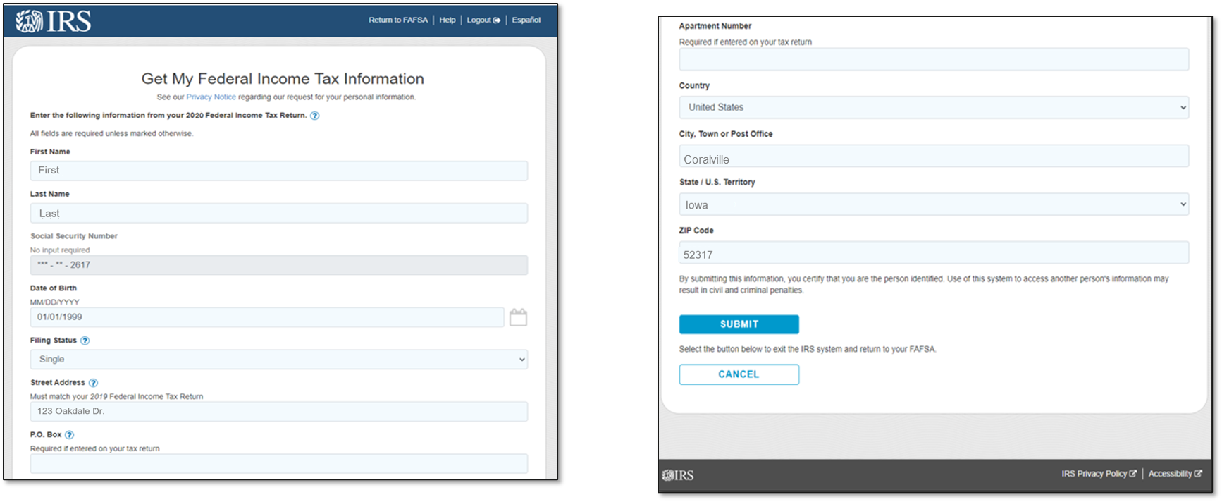
Personal Information, Top Section, Parent – IRS Site
The SSN cannot be changed.
The first name, last name, date of birth, filing status and address may be changed.
These must EXACTLY match the IRS 1040.
Notes:
This is the first half of the Personal Information view.

Slide 45
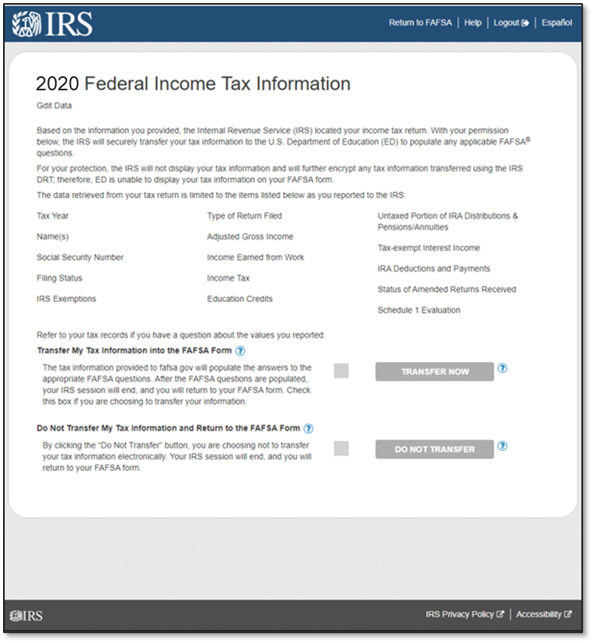
Results Page, Top Section, Parent – IRS Site
2021
Notes:
First Half of the Results Page

Slide 46
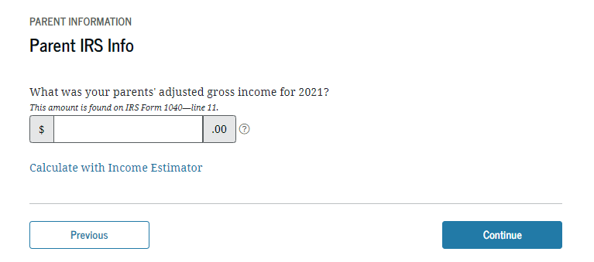
Parent Leaving FAFSA - Dependent
Confirmation of transfer
from the IRS or can manually
enter the information
Notes:
2020-21 “Parent Leaving FAFSA” view.

Slide 47
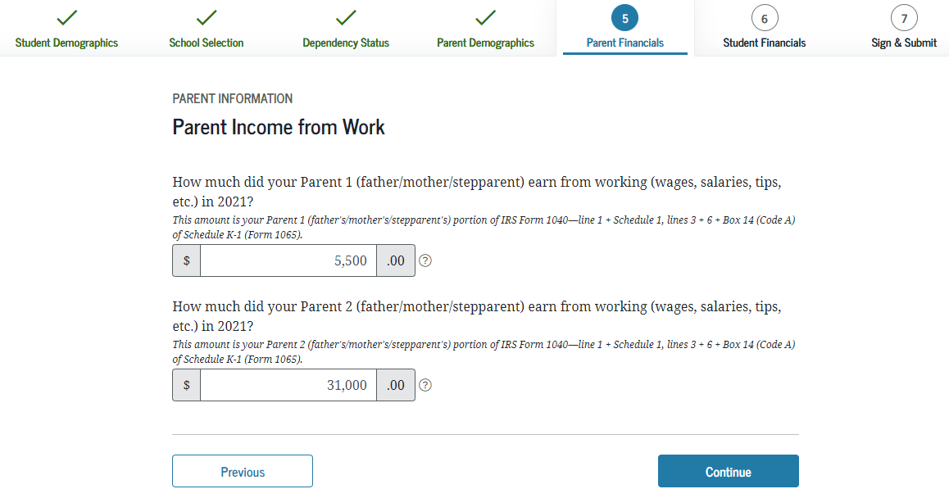
You Are Now Leaving This Page - Dependent
Notes:
2020-21 “ You Are Now Leaving This Page” view.

Slide 48
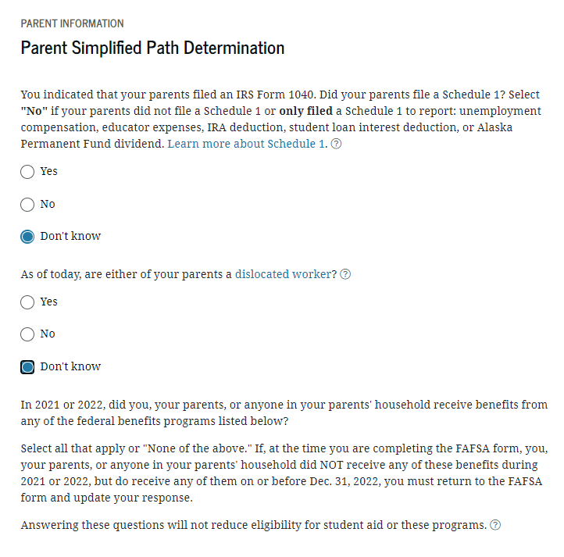
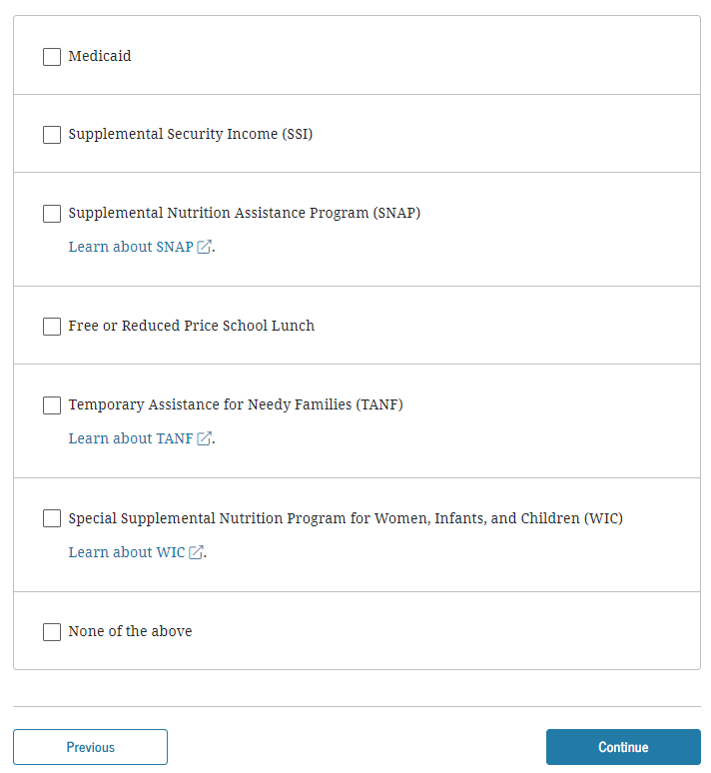
Parent Additional IRS Info - Dependent
Notes:
2020-21 “Parent Additional IRS Info” view.

Slide 49
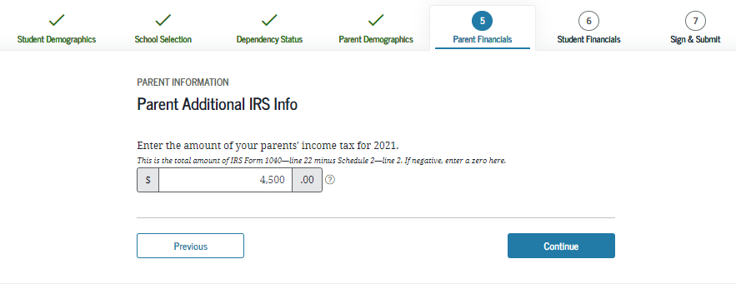
Parent Additional IRS Info - Dependent
Notes:
2020-21 “Parent Additional IRS Info” view.

Slide 50
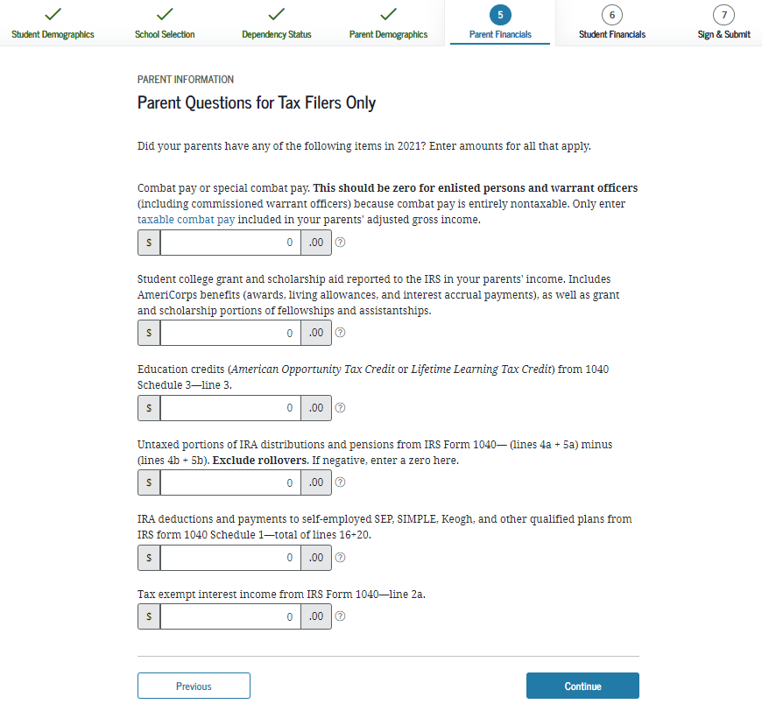
Parent Questions for Tax Filers Only – Dependent
Notes:
2020-21 “Parent Questions for Tax Filers Only” view.
Note: Additional instructional text has been added to help students and parents answer the combat pay question correctly.

Slide 51
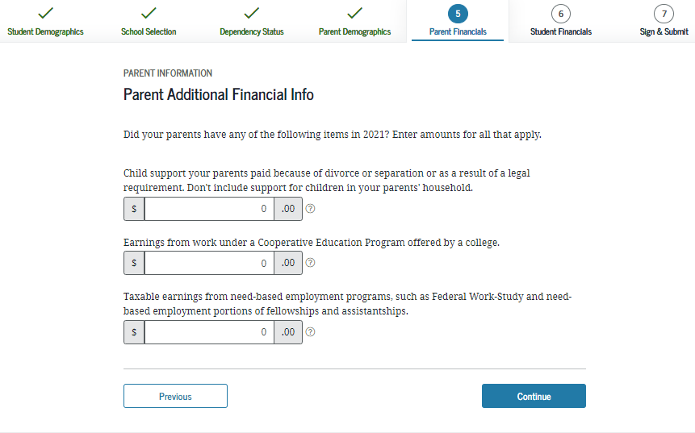
Parent Additional Financial Info - Dependent
Notes:
2020-21 “Parent Additional Financial Info” view.

Slide 52
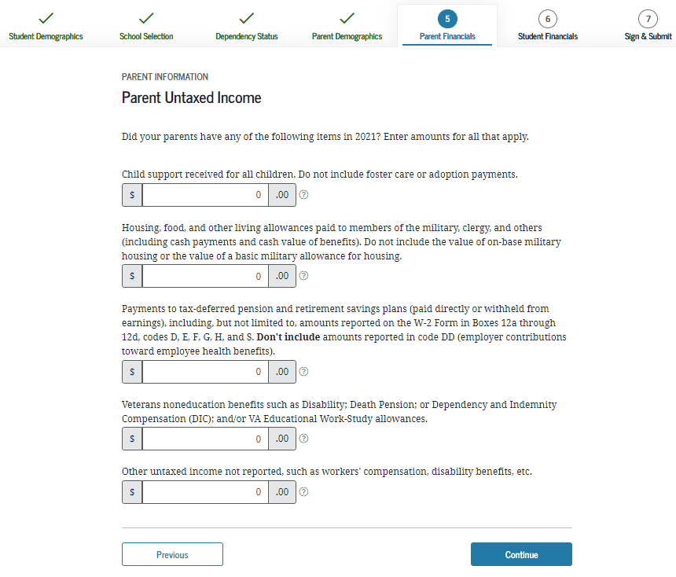
Parent Untaxed Income - Dependent
Notes:
2020-21 “Parent Untaxed Income” view.

Slide 53
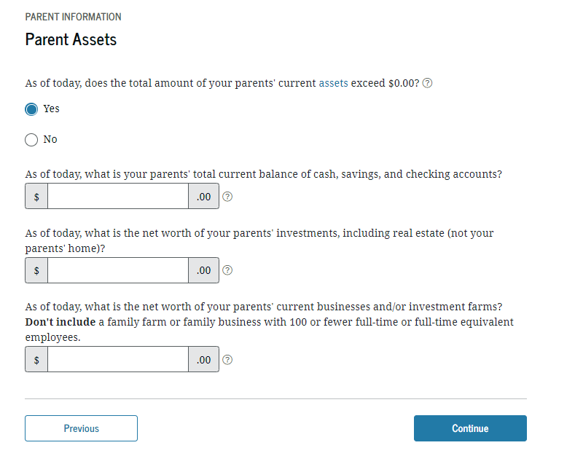
Parent Assets - Dependent
Notes:
2020-21 “Parent Assets” view.

Slide 54
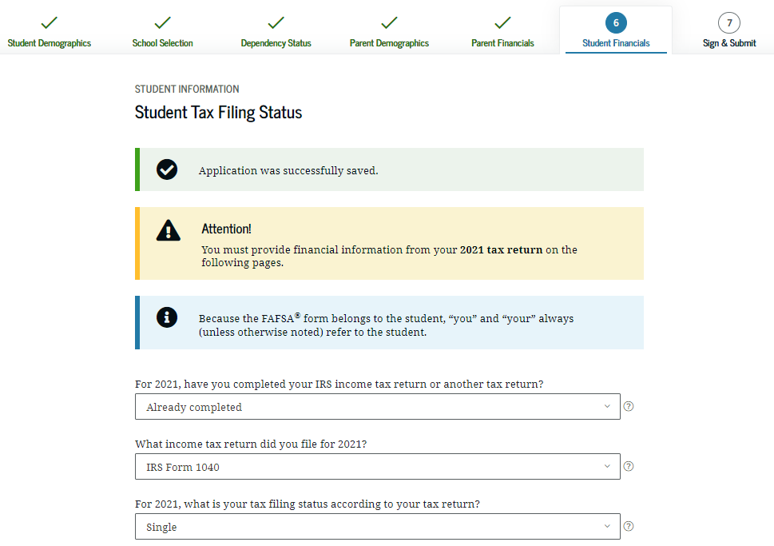
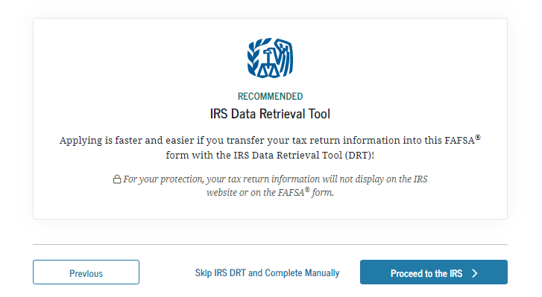
Student Tax Filing Status - Dependent
Student Financials
Will not file
Notes:
2020-21 “Student Tax Filing Status” view.
“Type of Tax Return” question has been moved from the “Student IRS Info” view and added to this view.
Note: This if first view of the Student Financials section.

Slide 55
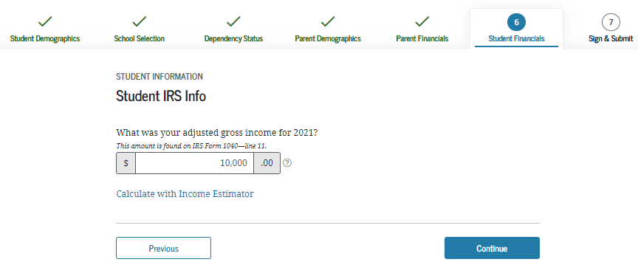
Student IRS Info - Dependent
If information is not transferred from the IRS
Question must be answered manually.
Notes:
2020-21 “Student IRS Info” view.
An alert message will indicate that the IRS Data was successfully transferred and will be identified as “Transferred from the IRS.”

Slide 56
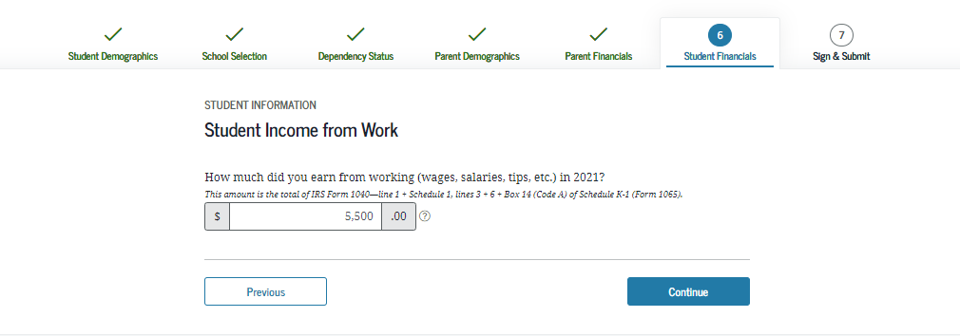
Student Income from Work - Dependent
Notes:
2020-21 “Student Income from Work” view.

Slide 57
Student Additional IRS Info - Dependent
Notes:
2020-21 “Student Additional IRS Info” view.

Slide 58
Student Questions for Tax Filers Only - Dependent
Notes:
2020-21 “Student Questions for Tax Filers Only” view.
Note: Additional instructional text has been added to help students and parents answer the combat pay question correctly.

Slide 59
Student Additional Financial Info - Dependent
Notes:
2020-21 “Student Additional Financial Info” view.

Slide 60
Student Untaxed Income - Dependent
Notes:
2020-21 “Student Untaxed Income” view.

Slide 61
Student Assets - Dependent
Notes:
2020-21 “Student Assets” view.

Slide 62
FAFSA Summary - Student Demographics and School Selection - Dependent
FAFSA Summary
Notes:
2020-21 “FAFSA Summary” view – Student Demographics and School Selection.

Slide 63
Signature Status – Dependent
Notes:
2020-21 “Signature Status” view.
This is where the applicant signs and actively acknowledges the Certification Statement.

Slide 64
Signature Status – Dependent
Signature Status
Notes:
2020-21 “Signature Status” view.
This is where the applicant signs and actively acknowledges the Certification Statement.

Slide 65
Preparer Info - Dependent
Sign & Submit
Notes:
2020-21 “Preparer Info” view.
Note: This is the first view of Sign & Submit section.

Slide 67
Signature Options, Student - Dependent
Notes:
2020-21 “Signature Options” view.

Slide 70
Signature Status, Student Signature Accepted - Dependent
FAFSA Results
Notes:
2020-21 “Signature Status” view.
Student signature accepted, and now the parent will need to sign.

Slide 71
NJ DREAMERS Application Process
HESAA.org

Slide 72
NJ DREAMERS

Slide 73
NJ Dreamers Application Location

Slide 74
Student Portal Welcome Page
Your 2023-2024 FAFSA has been received
Your 2022-2023 FAFSA has not been received

Slide 75
Student Portal
New Jersey Financial Aid Management System

Slide 76
To Do List
All incomplete tasks will be listed
All outstanding documents will be listed

Slide 77
Apply Online for Scholarships
Notes:
This will show as an incomplete item until the student finishes the application. If they applied by mistake this incomplete item will not stop the verification/awarding process.

Slide 78
Award and Eligibility Information
Provides clear language on TAG as an estimated award & emphasizes the deadlines. New Icon – PV = Pending Verification

Slide 79
Award and Eligibility Information
Notes:
Each New Jersey Institutions listed on the FAFSA or added by the student will display an estimated award status

Slide 80
FAFSA Filing Deadlines &
Complete State Record Deadlines
All students who
received TAG during
22-23 academic year MUST complete
the 2023-2024 FAFSA by April 15, 2023.
All other student must file by September 15, 2023. All requests listed on the students NJFAMS “To Do” list
Must be submitted or completed by October 1, 2023 for the 23-24 academic year.
Notes:
Please keep in mind that HESAA has two different sets of State Deadlines. I will only refer to the 2018-2019 deadlines
First there is:
HESAA's FAFSA Filing Deadlines – The FAFSA must be RECEIVED by the Federal processor (not postmarked) by the dates shown to be considered for the Tuition Aid Grant (TAG), Governor’s Urban Scholarship, NJ STARS and NJ STARS II programs:
Keep in mind that EOF Students who received TAG in the prior year will have a April 15th deadline for TAG but will have a September 15th deadline for EOF
In addition Keep in mind that a NJSTARS Students who received TAG in the prior year will have a April 15th deadline for TAG but will have a September 15th deadline for NJSTARS
File Completion Deadlines: All information and documents must be received from the student or institution by the deadlines
Your eligibility may be reevaluated if there is an error in the information reported. See your financial aid officer for assistance in correcting errors by the state deadlines.
If there has been a change in your family’s circumstances because of death, disability, retirement, divorce or separation, loss of untaxed income or change in employment status see your financial aid officer for assistance in reporting these changes by the state deadlines.
Consideration of appeals of ineligibility must be submitted in writing or e-mail within 60 days of your first notification, addressed to the Director of Grants and Scholarships at PO BOX 540, Trenton NJ, 08625-0540, or you can upload your appeal electronically through our electronic document collection process. Please be sure to include the student’s NJHESAA ID number and student's full name.
In accordance with State law, the value of your grant may decrease depending upon appropriated funds, actual tuition charges, cost of attendance, estimated family contribution and other available resources.
Penalty For False Information – If you qualify for state student financial assistance by purposely reporting false or misleading information, you may be subject to a $20,000 fine and/or imprisonment.

Slide 81
Questions?
Thank You

